Slide 1
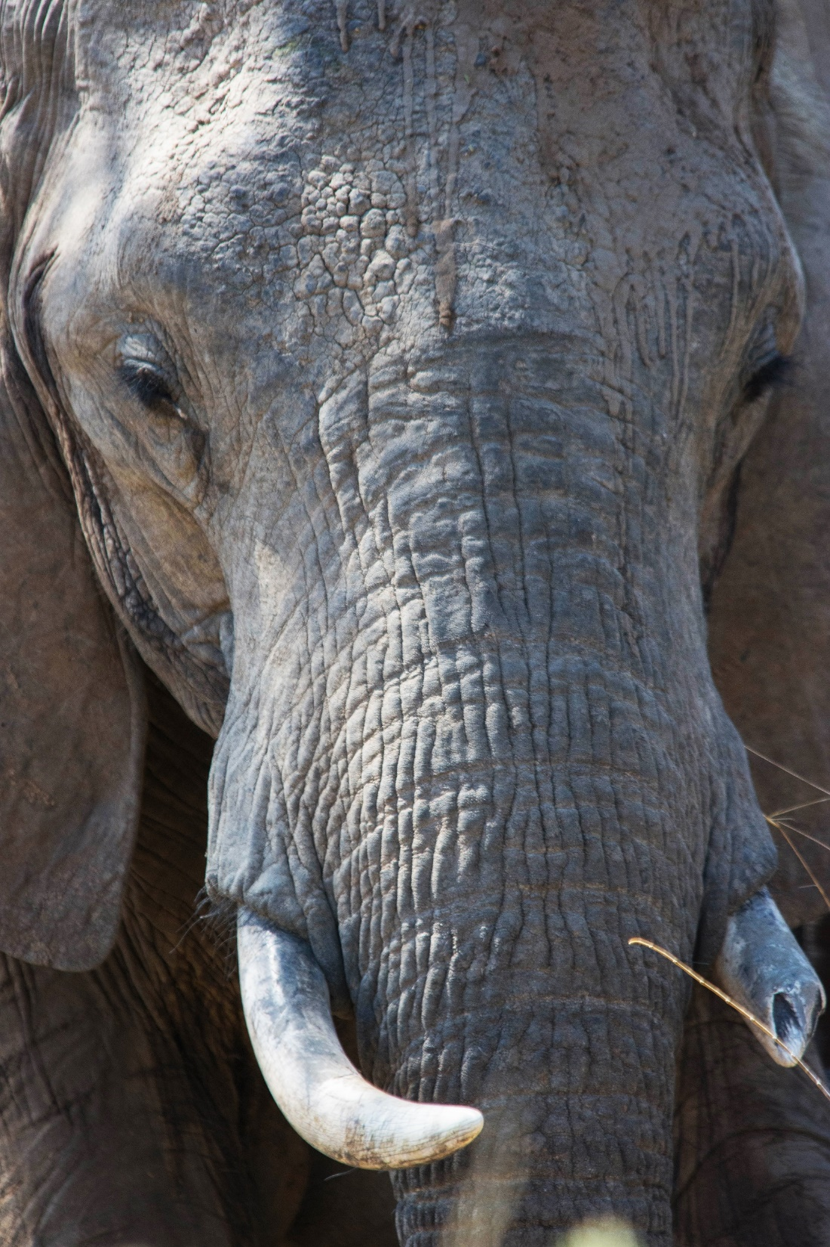
Hackathon Rules Mahvash Siddiqui
@USAinUK

Slide 2
5X CHALLENGE STATEMENTS GLOBAL AND LOCAL PRIZES 48 HOURS – PRESENTATIONS 2 PM SUN Final Submission at 13:59 (UK time), October 8th. Register!!! (https://zoohackathon2017.devpost.com)

Slide 3
Presentation Guidelines
All submissions must include a demonstration (e.g. PowerPoint) or other visual digital presentation software of the app/or solution.
Presentations should be approximately three minutes in length.
Original work of team (ok to use open source)

Slide 4
Presentations should include:
Problem statement your technological product seeks to address
Introduction to your product
How it works
What resources are needed for the implementation of the product
Ways in which it can be implemented
A real life situation your product will address and the impact of that change on the community/city/country
Please submit presentations before judging starts.
Please be ready for two minutes of QnA by Judges and 2 minutes of QnA by others in Zoohackathon

Slide 5
Coding Guidelines
You can only choose one problem/challenge statement per team
It is recommended that the app run on one of the following platforms:
Android
iOS
SMS
Windows desk/mobile
Blackberry
Web or mobile Web
Raspberry Pi
Mac desktop
Kindle

Slide 6
Judging Criteria
QUALITY OF IDEA/INNOVATION
IMPACT
INTERFACE
(5 Judges, expertise in wildlife and tech)

Slide 7
Submission Rules
Original work of the entrants
Must not contain any advertisement or solicitation;
Must not contain anything that is or may be construed as inappropriate or protected by copyright, trademark or other
Must not contain any material that would give rise to criminal or civil liability
https://zoohackathon2017.devpost.com/submissions
Before 2 PM, Sunday October 8.

Slide 8
TEAMS: 4 PEOPLE MINIMUM TEAM REGISTRATION: BY SAT 10AM DON’T FORGET A GREAT TEAM NAME!

